Slide 1
Science update
23 August 2021

Slide 2
Production results

Slide 3
Early Lockdown
PRODUCTION

Slide 4
Early Lockdown
PRODUCTION

Slide 5
Early Intervention
PRODUCTION

Slide 6
Length of lockdown
PRODUCTION
April 15 start

Slide 7
Model summary

Slide 8
 | Data | Pi | Test | Prod
Early lockdown | 🟢 | 🟢🟢 | 🟢🟢 | 🟢🟢
Early intervention | 🟢 | 🟢 | 🟢 | 🟢
Length of lockdown
March 15 | 🟢 | 🟢 | 🟢 | 🏃🏃
April 15 | 🟢 | 🟢 | 🟢 | 🏃🟢

Slide 9
Questions

Slide 10
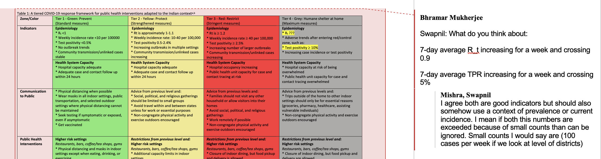
R2R
This seems like a lower hurdle than Rt > 1.2?

Slide 11
Add plots in R2R here?
d.2: As the reviewer pointed out, perpetual lockdowns are not feasible. At the time of the original submission, we did not have data on lifting of lockdowns in 2021. Thus, we only commented on the start date. Now that we have observed data, and we show the effect of lifting lockdowns both in 2020 as well as 2021. For example, for Maharashtra, the pi schedule being modeled includes a lockdown period of the observed length (April 14 to June 7), with a subsequent unlock period (June 7 to July 31). We also include simulation scenarios with varying length of lockdowns and indicate that if one is too late in starting a lockdown, extending the length have only modest incremental benefit.

Slide 12
Change title in MS and Supplement
Update authors in MS and Supplement
Affiliations?
Update Table R1 (Ram + Lakshmi’s table)
March 1 – June 15 annotated Maharashtra plot with pi schedules [see next slide]
Annotate
Update Table R2 (Maharashtra intervention table)
Hospitalization table
Add citations
Add R+L table explanation to Supplement
Add Aditi citations to R2R
Reorganize manuscript per Bhramar’s email

Slide 14
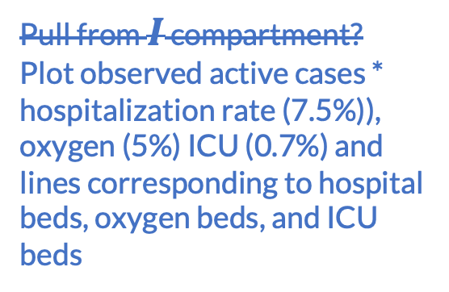
Previously discussed
Per 10,000 infections
11% of hospitalized go on to ICU admission (Sibal 2021)
13.72% mortality rate if hospitalized (Malhotra 2021)
5% need oxygen support, 0.7% ICU care (“underestimate” of data from Odisha)
Estimates of hospitalization need in India [Laxminarayan]
6.04% in persons aged 0-64 years; 28.17% in persons 65 years and over will require hospitalization [Liu et al. 2020)
7.5% for hospitalization and 11% of hospitalized to ICU (0.075*0.11 of cases); 13% of hospitalized die
750 per 10,000 reported cases need hospital beds
Oxygen beds
82.5 per 10,000 reported cases need ICU bed
Active number
Pull from $I$ compartment?
Plot observed active cases * hospitalization rate (7.5%)), oxygen (5%) ICU (0.7%) and lines corresponding to hospital beds, oxygen beds, and ICU beds
https://healthitanalytics.com/news/majority-of-covid-19-hospitalizations-due-to-4-chronic-diseases

Slide 15
Test run of early
India lockdown
on March 30

Slide 16
Test run of early
India lockdown
on March 30

Slide 17
Test run of early
India lockdown
on March 30

